Slide 1
US Sales Tax Analysis
Landry Edi
Maulik Patel
Osman Bangura
Srinivasa Rao Vikram

Slide 2
Objective
Analysis of sales tax in US States
States that have or don’t have taxes
Find States with lower taxes and States with higher taxes
Identify the impact of multiple tax levels in States

Slide 3
Data Source and Definitions
We define:
State Tax: The sales tax rate applied for each sale in the state
Local Tax: The sum of sales tax rate applied for each sale that are imposed by Counties, Cities and Districts
Tax Level: The number of different sales tax applied for a sale in a state, e.g. if a state has only state level tax, then the tax level for that state is considered to be 1, and if in a state, there is a location where there is application of state tax as well as county tax, that state is considered to have tax level 2, and so on...
Data Source: https://www.avalara.com/taxrates/en/state-rates.html

Slide 4
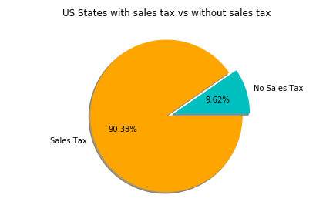
States with State Sales Tax vs No Sales Tax
We have total 50 states and 2 territories
5 States do not have sales tax: 9.62%
Remaining 45 States and 2 territories have sales tax: 90.38%
State State Name
AK Alaska
DE Delaware
MT Montana
NH New Hampshire
OR Oregon

Slide 5
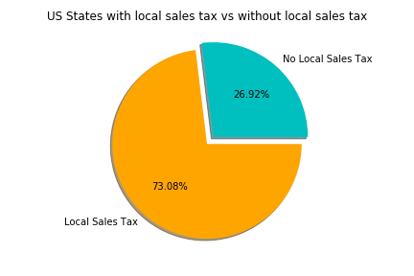
States with Local Sales Tax vs No Local Sales Tax
We have total 50 states and 2 territories
13 States and 1 terriotory do not have local sales tax: 26.962%
Remaining 37 States and 1 territory have local sales tax: 73.08%
State Name
Connecticut, District of Columbia, Delaware, Indiana, Kentucky, Massachusetts, Maryland, Maine, Michigan, Montana, New Hampshire, New Jersey, Oregon, Rhode Island

Slide 6
Total Sales Tax Analysis
Top 5 states that have highest total sales tax Top 5 states that have lowest total sales tax
State | State Name | Estimated Combined Rate
PR | Puerto Rico | 0.114659
TN | Tennessee | 0.094904
LA | Louisiana | 0.091396
WA | Washington | 0.086900
AR | Arkansas | 0.086232
State | State Name | Estimated Combined Rate
DE | Delaware | 0.00000
MT | Montana | 0.00000
NH | New Hampshire | 0.00000
OR | Oregon | 0.00000
AK | Alaska | 0.01893

Slide 7
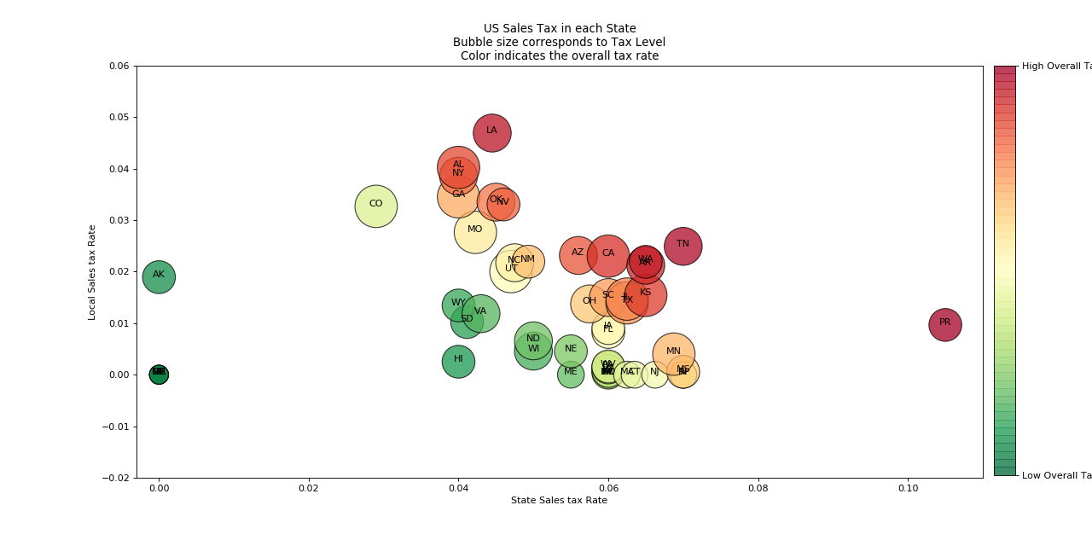
Overall Tax Analysis
Analysis:
We can see that states with high taxes have high state taxes and also have local taxes, i.e. they have more than 1 level of tax applied.

Slide 8
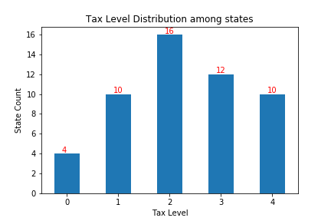
Tax Level Distribution

Slide 9
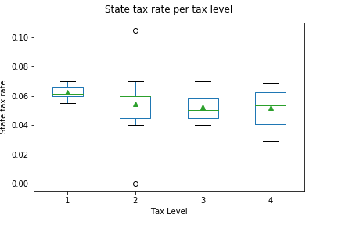
State Tax rate dependency with Tax Level
States have higher taxes when the state tax is the only applied tax.
When a local tax is imposed, we can notice that the state tax is decreased in general; however, it seems to not decrease further as more local tax levels get added. This will lead to overall tax increase if more than 1 local taxes get applied.

Slide 10
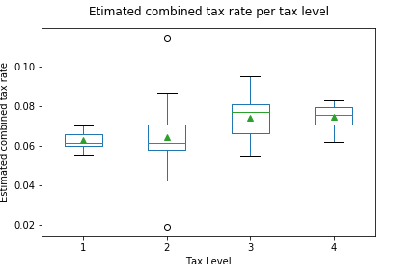
Overall Tax rate dependency with Tax Level
In conformity with the previous analysis, we can see that there seem to not be any difference between states with just state level tax and state with state level and one local level tax. However, we see an increase in tax rate for states with more than 1 level local tax

